Slide 1
Chapter 5
Linked List by www.asyrani.com

Slide 2
Before you learn Linked List
3rd level of Data Structures
Intermediate Level of Understanding for C++
Please make sure to properly and slowly digesting the topics.
We are going to take a deep breath now

Slide 3

List Definition
List – A sequence of elements in certain linear order
[English] List is where you put what to do one by one in sequence

Slide 4
Basic Operations
Traversing
Searching/retrieving
Inserting
Removing/deleting an element given its position

Slide 5
Basic Operations [English]
Traversing – Where you navigate your shopping list one by one
Searching/Retrieving – Where you starting to find out specific items that you want to buy in your shopping list
Inserting – Insert new stuff to buy in your shopping list
Removing/Deleting – Where you strike out the things that you have bought

Slide 6
Types of common lists
Stacks and queues, where insertions and deletions can be done only at the head or the tail of the sequence. That is the rules!!!
Head
Tail

Slide 7
Linked list

Slide 8
What is Linked List?
A linked list is a series of nodes
Node 0
Node 1
Node 4

Slide 9
What is Linked List?
Each node holds an item of data and a pointer(s) to the next node in the list
Node 0
Node 1
Node 2
Node 3
Node 4
Point to Node 1
Point to Node 3

Slide 10
What is Linked List?
The last node's pointer is set to null
NULL means end of node/no more nodes
Node 0
Node 1
Node 4
NULL

Slide 11
What is Linked List?
In order to hold on to a list, a program holds a pointer to the first node of the list.
Node 0
Node 1
Node 4
Point to
PROGRAM

Slide 12
Advantages
Contain data of any type, including objects of other classes.
Dynamic, so the length of a list can increase or decrease as necessary
Full only when the system has insufficient memory
Can be maintained in sorted order by inserting each new element at the proper point in the list
linked list allows efficient insertion operations anywhere in the list

Slide 13
Comparison
Array
Linked List
The size of a “conventional” C++ array however cannot be altered because the array size is fixed at compile time.
Cannot contain objects and classes
Arrays can become full as it depends on our defined array
Time consuming
Existing elements need to be moved
Linked lists are dynamic, so the length of a list can increase or decrease as necessary.
Can contain objects and classes
Never becoming full unless computer does not have enough memory
Faster than array
Linked lists can be maintained in sorted order by inserting each new element at the proper point in the list

Slide 14
SINGLE LINKED LIST

Slide 15

Singly Linked List
Singly linked list is one of the most primitive data structures
Each node that makes up a singly linked list consists of a value/data and a reference to the next node (if any) in the list

Slide 16
SINGLY LINKED LIST OPERATIONS
Insertion
Searching
Deletion
Traversing

Slide 17
INSERTION

Slide 18
Insertion
Adding a node to the tail/end of the list
Node 0
Node 1
Node 2
Node 3
Node 4
Head
Tail

Slide 19
Insertion
Adding a node to a singly linked list has only two cases:
  Head = ∅ in which case the node we are adding is now both the head and tail of the list
  We simply need to append our node onto the end of the list updating the tail reference appropriately

Slide 20
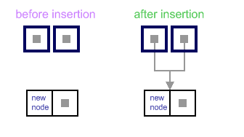
Insertion (Case)
Case 1 : Empty List Case
When list is empty, which is indicated by (head == NULL)condition, the insertion is quite simple. Algorithm sets both head and tail to point to the new node.

Slide 21
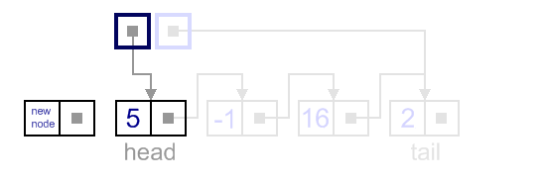
Insertion (Case)
Case 2 : Add First
In this case, new node is inserted right before the current head node.

Slide 22
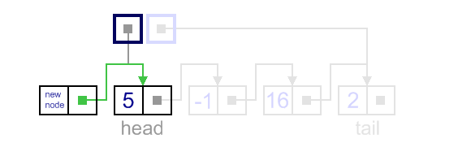
Insertion (Case)
Case 2 : Add First
1st Step : Update the next link of a new node, to point to the current head node.

Slide 23
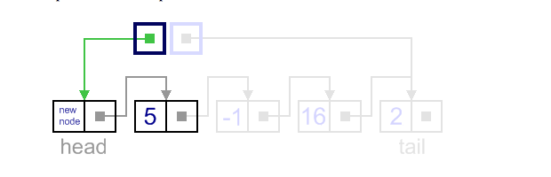
Insertion (Case)
Case 2 : Add First
2nd Step :
Update head link to point to the new node.

Slide 24
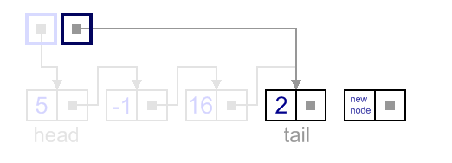
Insertion (Case)
Case 3 : Add Last
In this case, new node is inserted right after the current tail node.

Slide 25
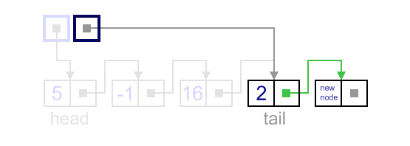
Insertion (Case)
Case 3 : Add Last
1st Step :
Update the next link of the current tail node, to point to the new node.

Slide 26
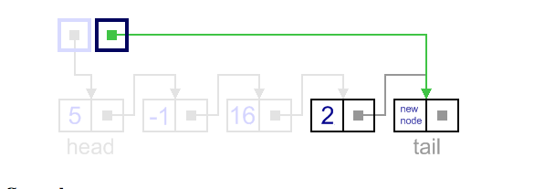
Insertion (Case)
Case 3 : Add Last
2nd Step :
Update tail link to point to the new node.

Slide 27
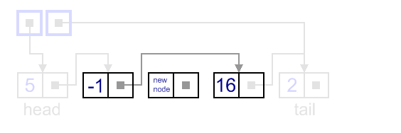
Insertion (Case)
Case 4 : General Case
In general case, new node is always inserted between two nodes, which are already in the list. Head and tail links are not updated in this case.

Slide 28
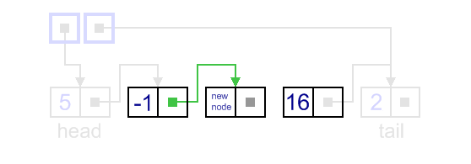
Insertion (Case)
Case 4 : General Case
1st Step :
Update link of the "previous" node, to point to the new node.

Slide 29
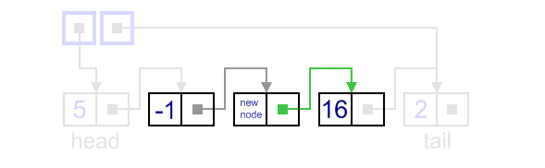
Insertion (Case)
Case 4 : General Case
2nd Step :
Update link of the new node, to point to the "next" node.

Slide 30
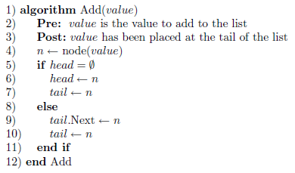
Singly Linked List: Insertion Algorithm

Slide 31
DELETION

Slide 32
Deletion

Slide 33
Singly Linked List: Deletion
Deleting a node from a linked list is also straightforward but there are a few cases we need to account for:
  The list is empty; or
  The node to remove is the only node in the linked-list; or
  We are removing the head node; or
  We are removing the tail node; or
  The node to remove is somewhere in between the head and tail; or
  The item to remove doesn’t exist in the linked-list

Slide 34
Singly Linked List: Deletion Algorithm
The algorithm whose cases we have described will remove a node from anywhere within a list irrespective of whether the node is the head, etc.

Slide 35
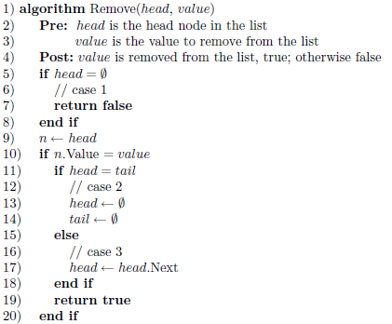
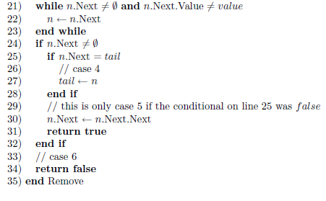

Singly Linked List: Deletion Algorithm

Slide 36
SEARCHING

Slide 37
Singly Linked List: Searching
Searching a linked-list is straightforward
Traverse the list, checking the desired value/data with the value of each node in the linked-list

Slide 38
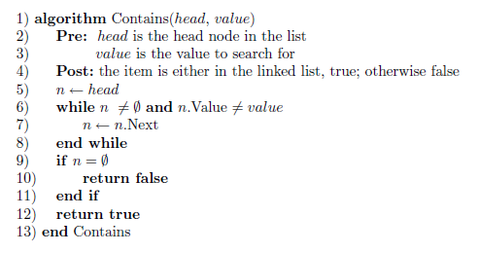
Singly Linked List: Searching Algorithm

Slide 39
TRAVERSING

Slide 40
Singly Linked List: Traversing the list
Same as traversing a doubly linked list
Start at the head and continue until come across a node that is ∅.
The two cases are as follows:
  Node = ∅, we have exhausted all nodes in the linked-list
  Must update the node reference to be node.Next

Slide 41
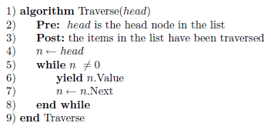
Singly Linked List: Traversing Algorithm

Slide 42
REVERSE TRAVERSING

Slide 43
Singly Linked List: Traversing the list in reverse order
Need to acquire a reference to the predecessor of a node (for singly linked list, this is an expensive operation)
For each node, finding its predecessor is an O(n) operation.
Over the course of traversing the whole list backwards the cost becomes O(n²)

Slide 44
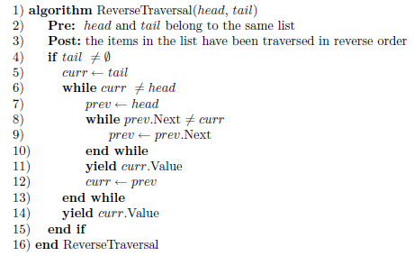
Singly Linked List: Reverse Traversal Algorithm

Slide 45
Singly Linked List: Reverse Traversal
The following figure depicts the previous reverse traversal algorithm being applied to a linked list with integers 5, 10, 1, and 40

Slide 46
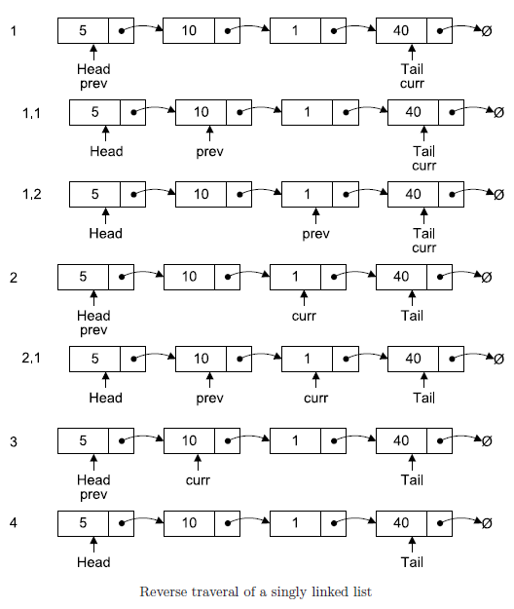

Slide 47
Linked List: Reverse Traversal
The algorithm is only of real interest when we are using singly linked list
Actually double linked list make reverse list traversal simple and efficient

Slide 48
DOUBLE LINKED LIST

Slide 49

Doubly Linked List
Is similar to singly linked list. The only difference is that each node has a reference to both the next and previous nodes in the list

Slide 50
Doubly Linked List
The following algorithms for the doubly linked-list are exactly similar as those listed previously for singly linked-list:
  Searching
  Traversal

Slide 51
Doubly Linked-list: Insertion
The only major difference with previous algorithm for singly linked-list is that we need to remember to bind the previous pointer of n to the previous tail node if n was not the first node to be inserted in the list

Slide 52
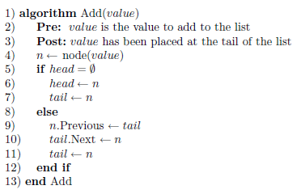
Doubly Linked-list: Insertion Algorithm

Slide 53
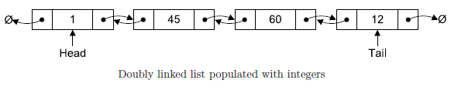
Doubly Linked-list: Insertion Algorithm
Example: adding the following sequence integers to a list: 1,45, 60 and 12 will result as follows:

Slide 54
Doubly Linked-list: Deletion
It is exactly the same as those algorithm defined in previous for singly linked-list. Like insertion, we have the added task of binding an additional reference (previous) to the correct value

Slide 55
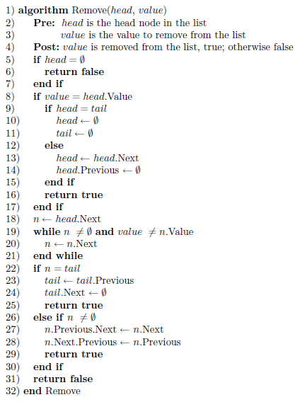
Doubly Linked-list: Deletion Algorithm

Slide 56
Doubly Linked-list: Reverse Traversal
Singly linked-list have a forward design, which is why the reverse traversal algorithm defined previously required some creative invention
Doubly linked-list make reverse traversal as simple as forward traversal, except that we start at the tail node and update the pointers in the opposite direction

Slide 57
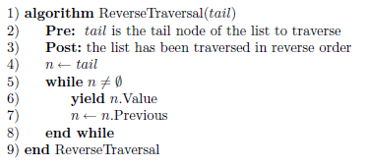
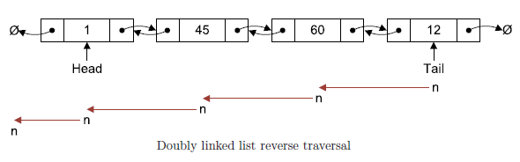
Doubly Linked-list: Reverse Traversal Algorithm

Slide 58
The end

