Slide 1
CHAPTER 6
SORTING ALGORITHMS
www.asyrani.com/data

Slide 2

Sorting
What is definitely a sorting?

Slide 3
Sorting Definition
Sorting is the process of sequencing or arranging a list of data items
Custom Order
Descending
Ascending

Slide 4
Purpose of Sorting
Improve Search/Access time
Without sorting take longer time
Best for large data

Slide 5
Example of Sorting
Sorting list name
Student Ranking, etc
Sorting number
according to account number, customer number
Sorting by specific means
Sorting according to age, salary, etc

Slide 6
Type of Sorting
Sorting
Bubble sort
Selection sort
Insertion sort
Quicksort
Mergesort
Heapsort
(Good for Large Data)
(Good for Large Data)

Slide 7
Sorting Algorithms and Average Case Number of Comparisons
Simple Sorts
  Bubble Sort
  Straight Selection Sort
  Insertion Sort
More Complex Sorts
  Quick Sort
  Merge Sort
  Heap Sort
  There are several sorts that are relatively easy to code. These are considered to be "simple sorts" and generally have bad run time O(n²).
O(N²)
O(N*log N)
7

Slide 8
Big-O notation
For efficiency calculation
Algorithm efforts
Complexity of algorithm

Slide 9
“JUM” calculate Big-O
bool IsFirstElementNull(String[] strings)
{
if(strings[0] == null)
{
return true;
}
return false;
}
This Big-O is O(1)
Ok, how do I get that?
Because we just iterate it just once. You don’t loop it.
Let’s go for another example

Slide 10
“JUM” calculate Big-O
bool ContainsValue(String[] strings, String value)
{
for(int i = 0; i < strings.Length; i++)
{
if(strings[i] == value)
{
return true;
}
}
return false;
}
This Big-O is O(n)
Ok, how do I get that?
An algorithm whose performance will grow linearly and
in direct proportion to the size of the input data set
- Meaning that we will do it linearly from i = 0,1,2,3,… until equal to the strings.Length

Slide 11
“JUM” calculate Big-O
bool ContainsDuplicates(String[] strings)
{
for(int i = 0; i < strings.Length; i++)
{
for(int j = 0; j < strings.Length; j++)
{
if(i == j) // Don't compare with self
{
continue;
}
if(strings[i] == strings[j])
{
return true;
}
}
}
return false;
}
This Big-O is O(n^2)
Ok, how do I get that?
It will grow under the power of n^2 because we first loop using for (i = 0), then we move inside and perform another for (j = 0,1,2,3) before we proceed with outside for i = 1,2,3,…

Slide 12
“JUM” calculate Big-O
Want to know more?
Just log on to
http://rob-bell.net/2009/06/a-beginners-guide-to-big-o-notation/

Slide 13
Big-O Complexity
Sorting algorithms | Big-O
Insertion sort | O(n²)
Selection sort | O(n²)
Bubble sort | O(n²)
Quick sort | Worst case: O(n²) Average case: O(nlogn)
Merge sort | O(nlogn)

Slide 14

BUBBLE SORT

Slide 15
So what is Bubble Sort
Simple explanation
“What Bubble Sort do is just arrange some unordered list by comparing its nearest neighbor into an arranged order according to our specification either ascending, descending or custom order”

Slide 16
Example : Ascending Order
Default | 4 | 2 | 1 | 6 | 9 | 7
Pass 1 | 2 | 1 | 4 | 6 | 7 | 9
Pass 2 (Done) | 1 | 2 | 4 | 6 | 7 | 9
It will compare with the right column.
First the number 4 will be compared with 2. Then because number 2 is lower than 4, then 2 will replace the number 4 place and 4 will be moved into the 2 place.
Next, the number 4 is compared with the number 1 and it happened that number 1 is lower than 4, so 4 will be moved into 1 position and 1 will replace 4 position.
And the process continue until the end of the list

Slide 17
Example : Ascending Order
Default | 4 | 2 | 1 | 6 | 9 | 7
Pass 1
4 will be compared with 2
Default | 4 | 2 | 1 | 6 | 9 | 7
Pass 1 | 2 | 4
Thus, we found that , 2 is lower than 4. Hence we “swap” both

Slide 18
Example : Ascending Order
Default | 4 | 2 | 1 | 6 | 9 | 7
Pass 1 | 2 | 4
Now, we will compared between 4 and 1.
Default | 4 | 2 | 1 | 6 | 9 | 7
Pass 1 | 2 | 1 | 4
Which one is lower? Of course 1!! Swap again

Slide 19
Example : Ascending Order
Default | 4 | 2 | 1 | 6 | 9 | 7
Pass 1 | 2 | 1 | 4
Now, between 4 and 6. We will just leave it because 4 is lower than 6
Default | 4 | 2 | 1 | 6 | 9 | 7
Pass 1 | 2 | 1 | 4 | 6
Copy number 6 to pass 1 row

Slide 20
Example : Ascending Order
Default | 4 | 2 | 1 | 6 | 9 | 7
Pass 1 | 2 | 1 | 4 | 6
Same thing. Just leave it 6 and 9 because 6 is lower than 9
Default | 4 | 2 | 1 | 6 | 9 | 7
Pass 1 | 2 | 1 | 4 | 6 | 9
Just copy the 9 to Pass 1

Slide 21
Example : Ascending Order
Default | 4 | 2 | 1 | 6 | 9 | 7
Pass 1 | 2 | 1 | 4 | 6 | 9
Hah! Now we can compared and found that 7 is lower than 9. Switch place!!!!
Default | 4 | 2 | 1 | 6 | 9 | 7
Pass 1 | 2 | 1 | 4 | 6 | 9 | 7
Yup, the PASS 1 is completed.
Now for PASS 2….

Slide 22
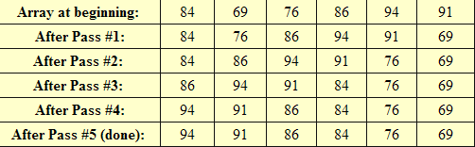
Example : Descending Order

Slide 23
Do yourself : Descending Order
Default | 4 | 2 | 1 | 6 | 9 | 7
Pass 1

Slide 24
Coding example
void bubble (int array[], int size, int select)
{
int i, j, temp;
for(i=0; i<size-1; i++)
for(j=1; j<size; j++)
{
if((array[j]<array[j-1])&&(select==1))//ascending order
{
temp=array[j];
array[j]=array[j-1];
array[j-1]=temp;
}
else if((array[j]>array[j-1])&&(select==2))//descending order
{
temp=array[j];
array[j]=array[j-1];
array[j-1]=temp;
}
}
}

Slide 25
Disadvantages of bubble sort
Disadvantages
Simple but slow
One extra check even after the list has been sorted

Slide 26

Selection sort

Slide 27
What is selection sort
Cut the story short
“We find the smallest/largest elements and move to its actual position and we do swapping”
Understand?
Pros: Simple and easy to implement.
Cons: Inefficient for large lists, so similar to the more efficient insertion sort that the insertion sort should be used in its place.

Slide 28
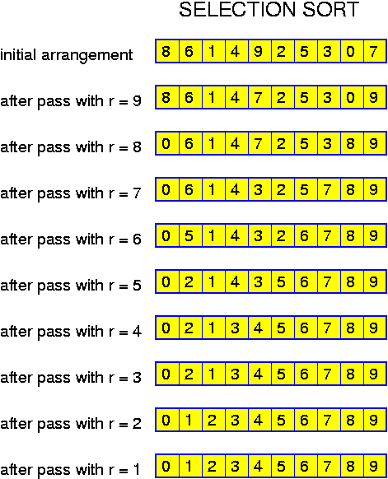
What is selection sort

Slide 29
Example : Ascending Order
Default | 4 | 2 | 1 | 6 | 9 | 7
Pass 1
Pass 2
At First, we try to search through the list to find the largest value (in this example – the largest one)
Default | 4 | 2 | 1 | 6 | 9 | 7
Pass 1 |  |  |  |  | 7 | 9
We found “9” and put it at the end of list. And we put “7” to replace “9” position

Slide 30
Example: Ascending Order
Default | 4 | 2 | 1 | 6 | 9 | 7
Pass 1 | 4 | 2 | 1 | 6 | 7 | 9
Pass 2 | 4 | 2 | 1 | 6 | 7 | 9
Pass 3 | 4 | 2 | 1 | 6 | 7 | 9
Pass 4 | 1 | 2 | 4 | 6 | 7 | 9
Pass 5 | 1 | 2 | 4 | 6 | 7 | 9
Now, we only need to exclude “9” from its searching algorithm. But we look back for the rest. Now, the largest one is 7. And its stay.

Slide 31
Example: Optimized Ascending Order
Default | 4 | 2 | 1 | 6 | 9 | 7
Pass 1 | 4 | 2 | 1 | 6 | 7 | 9
Every pass we need to find the largest elements.
But, for number “6” and “7”, we don’t want to run multiple pass just to find largest number.
So, what we have to do is to label the second largest elements.
For example. Current largest is 4. Then we find if there is any number largest than 4. So, it is number 6.
Then, we will find the another largest. So, we will get number “7” to replace the largest of “6”. “7” becomes the largest, “6” becomes the 2nd largest. So, we just leave it there.
Notice that we could also create for 3rd largest.

Slide 32
Example: Descending Order
While being an easy sort to program, the selection sort is one of the least efficient. The algorithm offers no way to end the sort early, even if it begins with an already sorted list.
Selection sort for descending order
Begin: 84 69 76 86 94 91
Pass1: 94 69 76 86 84 91
Pass2: 94 91 76 86 84 69
Pass3: 94 91 86 76 84 69
Pass4: 94 91 86 84 76 69
Pass5: 94 91 86 84 76 69
(done)

Slide 33
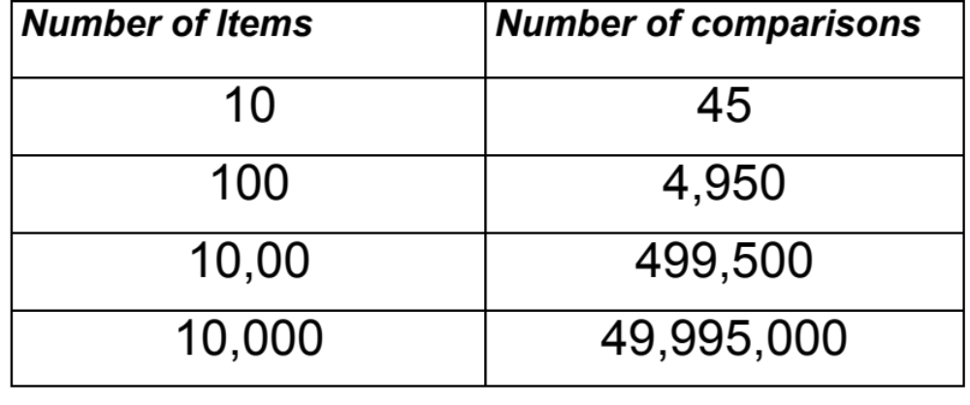
Number of Comparisons

Slide 34
Selection sort (continue)
for(a=0;a<size;a++)
{
smallest=a;
for(b=a+1;b<size;b++)
if(data[b]<data[smallest])
smallest=b;
temp=data[a];
data[a]=data[smallest];
data[smallest]=temp;
}
Algorithm: array A with n elements
Find the smallest of A[1],A[2]…A[n] and swap the number in position A[1].
Find the next smallest value and swap in the 2nd position A[2]. (A[1]≤A[2]).
Continue process until A[n-1]≤A[n].

Slide 35
Coding example
void selectionSort(intdata[], intarray_size)
{
int i, j;
int min, temp;
for (i= 0; i< array_size-1; i++)
{
min = i;
for (j = i+1; j < array_size; j++)
{
if (data[j] < data[min])min = j;
}
temp = data[i];
data[i] = data[min];
data[min] = temp;
}
}

Slide 36

Insertion sort

Slide 37
Insertion sort
passes through the array only once
Pick unsorted card, and insert it into organized cards
Have two sub-arrays
The first sub-array is always sorted and gets larger as the sort continues.
The second sub-array is unsorted and contains all the elements not yet inserted into the first sub-array.
The second sub-array gets smaller as the sort progresses.

Slide 38
Insertion Sort
6
10
24
Works like someone who “inserts” one more card at a time into a hand of cards that are already sorted.
To insert 12, we need to make room for it by moving first 36 and then 24.
36
12

Slide 39
Insertion Sort
10
24
Works like someone who “inserts” one more card at a time into a hand of cards that are already sorted.
To insert 12, we need to make room for it by moving first 36 and then 24.
6
36
12

Slide 40
Insertion Sort
6
10
24
Works like someone who “inserts” one more card at a time into a hand of cards that are already sorted.
To insert 12, we need to make room for it by moving first 36 and then 24.
36
12

Slide 41
Insertion Sort
12
Works like someone who “inserts” one more card at a time into a hand of cards that are already sorted.
To insert 12, we need to make room for it by moving first 36 and then 24.
6
10
24
36

Slide 42
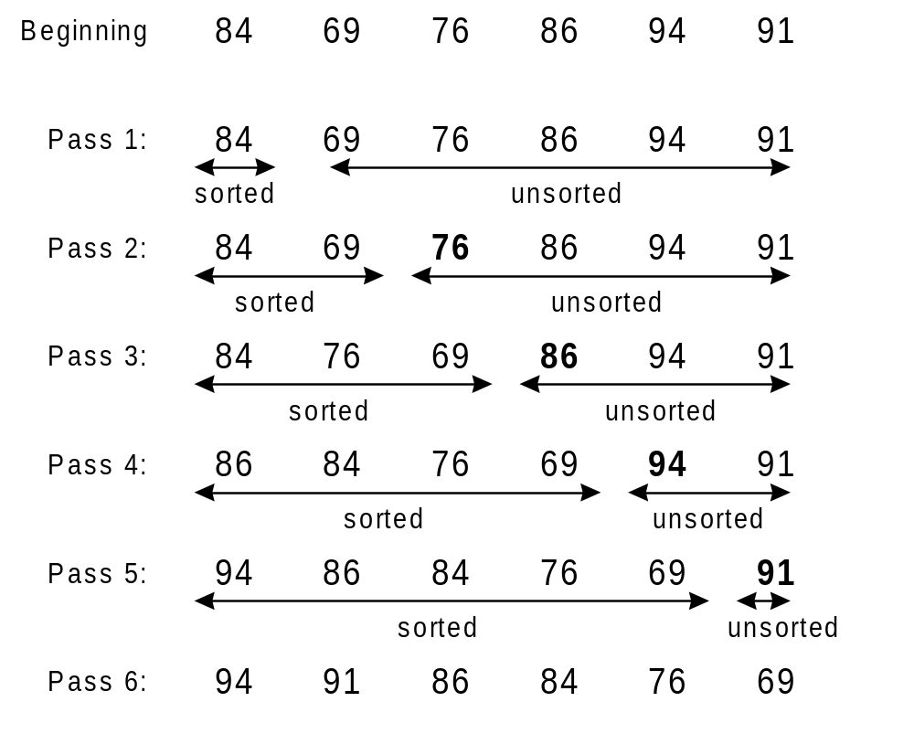
Example
Descending order
insertion sort is over twice as fast as the bubble sort and almost 40% faster than the selection sort.

Slide 43
Coding
void insertion_sort(int x[],int length)
{
int key,i;
for(int j=1;j<length;j++)
{
key=x[j];
i=j-1;
while(x[i]>key && i>=0)
{
x[i+1]=x[i];
i--;
}
x[i+1]=key;
}
}

Slide 44
Let’s investigate how code works
Imagine you want to sort
Thus array size is equal to 6 [0,1,2,3,4,5]
Default | 40 | 23 | 11 | 66 | 93 | 57

Slide 45
Coding
void insertion_sort(int x[],int length)
{
int key,i;
for(int j=1;j<length;j++)
{
key=x[j];
i=j-1;
while(x[i]>key && i>=0)
{
x[i+1]=x[i];
i--;
}
x[i+1]=key;
}
}
We declared some variables
And a FOR loop according to the size of an array. IN THIS CASE. Length = 6
Default | 40 | 23 | 11 | 66 | 93 | 57

Slide 46
Coding
void insertion_sort(int x[],int length)
{
int key,i;
for(int j=1;j<length;j++)
{
key=x[j];
i=j-1;
while(x[i]>key && i>=0)
{
x[i+1]=x[i];
i--;
}
x[i+1]=key;
}
}
j = 1, length = 6.
We don’t bother with j = 0 because we will always set the first element in array[0] is default sorted array.
Default | 40 | 23 | 11 | 66 | 93 | 57

Slide 47
Coding
void insertion_sort(int x[],int length)
{
int key,i;
for(int j=1;j<length;j++)
{
key=x[j];
i=j-1;
while(x[i]>key && i>=0)
{
x[i+1]=x[i];
i--;
}
x[i+1]=key;
}
}
Put x[1] into key.
So key = 23
And then put i = 0 (since j-1=0)
Default | 40 | 23 | 11 | 66 | 93 | 57
Pass 1 | 40

Slide 48
Coding
void insertion_sort(int x[],int length)
{
int key,i;
for(int j=1;j<length;j++)
{
key=x[j];
i=j-1;
while(x[i]>key && i>=0)
{
x[i+1]=x[i];
i--;
}
x[i+1]=key;
}
}
Ok, we check first
x[0]=40 > key = 23
And i=0 is equal/greater than 0
Thus:-
x[0+1]=40
i– means i=-1
Default | 40 | 23 | 11 | 66 | 93 | 57
Pass 1 | 40

Slide 49
Coding
void insertion_sort(int x[],int length)
{
int key,i;
for(int j=1;j<length;j++)
{
key=x[j];
i=j-1;
while(x[i]>key && i>=0)
{
x[i+1]=x[i];
i--;
}
x[i+1]=key;
}
}
Then,
x[-1+1] =x[0]= key = 23
Default | 40 | 23 | 11 | 66 | 93 | 57
Pass 1 | 23 | 40

Slide 50
Coding:2nd pass
void insertion_sort(int x[],int length)
{
int key,i;
for(int j=1;j<length;j++)
{
key=x[j];
i=j-1;
while(x[i]>key && i>=0)
{
x[i+1]=x[i];
i--;
}
x[i+1]=key;
}
}
key=x[2]=11
i = 1
while(x[1]>key && i>=0
x[2]=40
i-- (i=0)
While(x[0]>key && i>=0
x[1]=23
i-- (i=-1)
x[0]=11
Default | 40 | 23 | 11 | 66 | 93 | 57
Pass 1 | 23 | 40 | 11 | 66 | 93 | 57
Pass 2 | 11 | 23 | 40 | 66 | 93 | 57

Slide 51
Coding:2nd pass
void insertion_sort(int x[],int length)
{
int key,i;
for(int j=1;j<length;j++)
{
key=x[j];
i=j-1;
while(x[i]>key && i>=0)
{
x[i+1]=x[i];
i--;
}
x[i+1]=key;
}
}
Please do the rest….
Default | 40 | 23 | 11 | 66 | 93 | 57
Pass 1 | 23 | 40 | 11 | 66 | 93 | 57
Pass 2 | 11 | 23 | 40 | 66 | 93 | 57
Pass 3 | 11 | 23 | 40 | 66 | 93 | 57
Pass 4 | 11 | 23 | 40 | 66 | 93 | 57
Pass 5 | 11 | 12 | 40 | 57 | 66 | 93

Slide 52
Or perhaps you have different idea?
void insertionSort ( int array[], int size) { int current = 1; int temp; int walker; while (current < size) { temp = array [current]; walker = current -1; while (( walker >= 0 )&&( temp < array [walker] )) { array[walker +1] = array[walker]; walker = walker -1; } array [walker+1] = temp; current = current + 1; } }
ACTUALLY IF SEARCH IN THE INTERNET, YOU WIILL FIND OUT THAT THERE ARE THOUSANDS OF CODE.

Slide 53
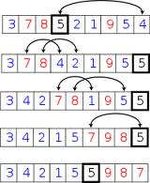
QUICKSORT

Slide 54
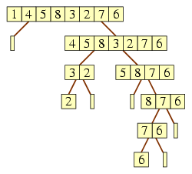
Quicksort
The quicksort is considered to be very efficient, with its "divide and conquer" algorithm. This sort starts by dividing the original array into two sections (partitions) based upon the value of the first item in the array.

Slide 55
EXAMPLE OF QUICKSORT
Default | 40 | 23 | 34 | 1 | 99 | 11 | 66 | 8 | 57
1ST STEP
CHOOSE A PIVOT. LET SAY “40”

Slide 56
EXAMPLE OF QUICKSORT
Default | 40 | 23 | 34 | 1 | 99 | 11 | 66 | 8 | 57
2ND STEP
Based on 40, we need to divide right and left of the pivot

Slide 57
EXAMPLE OF QUICKSORT
Default | 40 | 23 | 34 | 1 | 99 | 11 | 66 | 8 | 57
40 with 23
Default | 23 | 40
Default | 40 | 23 | 34 | 1 | 99 | 11 | 66 | 8 | 57
40 with 34
Default | 23 | 34 | 40

Slide 58
EXAMPLE OF QUICKSORT
Default | 40 | 23 | 34 | 1 | 99 | 11 | 66 | 8 | 57
40 with 1
Default | 23 | 34 | 1 | 40
Default | 40 | 23 | 34 | 1 | 99 | 11 | 66 | 8 | 57
40 with 99
Default | 23 | 34 | 1 | 40 |  |  |  |  | 99

Slide 59
EXAMPLE OF QUICKSORT
Default | 40 | 23 | 34 | 1 | 99 | 11 | 66 | 8 | 57
40 with 11
Default | 23 | 34 | 1 | 11 | 40 |  |  |  | 99
Default | 40 | 23 | 34 | 1 | 99 | 11 | 66 | 8 | 57
40 with 66
Default | 23 | 34 | 1 | 11 | 40 |  |  | 66 | 99

Slide 60
EXAMPLE OF QUICKSORT
Default | 40 | 23 | 34 | 1 | 99 | 11 | 66 | 8 | 57
40 with 11
Default | 23 | 34 | 1 | 11 | 8 | 40 |  | 66 | 99
Default | 40 | 23 | 34 | 1 | 99 | 11 | 66 | 8 | 57
40 with 66
Default | 23 | 34 | 1 | 11 | 8 | 40 | 57 | 66 | 99
40 IS SORTED

Slide 61
EXAMPLE OF QUICKSORT : LEFT PASS
Default | 23 | 34 | 1 | 11 | 8 | 40 | 57 | 66 | 99
23 WITH
Default | 23 |  |  |  | 34 | 40
Default | 23 | 34 | 1 | 11 | 8 | 40 | 57 | 66 | 99
23 WITH
Default | 1 | 23 |  |  | 34 | 40

Slide 62
EXAMPLE OF QUICKSORT : LEFT PASS
Default | 23 | 34 | 1 | 11 | 8 | 40 | 57 | 66 | 99
23 WITH
Default | 1 | 11 | 23 |  | 34 | 40
Default | 23 | 34 | 1 | 11 | 8 | 40 | 57 | 66 | 99
23 WITH
Default | 1 | 11 | 8 | 23 | 34 | 40
23 AND 34 ARE SORTED
IF THERE IS ONLY ONE ELEMENT. THERE IS NO NEED FOR SORTING

Slide 63
EXAMPLE OF QUICKSORT : LEFT PASS
Default | 1 | 11 | 8 | 23 | 34 | 40 | 57 | 66 | 99
1 WITH
Default | 1 |  | 11 | 23 | 34 | 40
Default | 1 | 11 | 8 | 23 | 34 | 40 | 57 | 66 | 99
1 WITH
Default | 1 | 8 | 11 | 23 | 34 | 40
1 IS SORTED

Slide 64
EXAMPLE OF QUICKSORT : LEFT PASS
Default | 1 | 8 | 11 | 23 | 34 | 40 | 57 | 66 | 99
8 WITH 11
Default | 1 | 8 | 11 | 23 | 34 | 40
8 AND 11 ARE SORTED

Slide 65
EXAMPLE OF QUICKSORT : RIGHT PASS
Default | 1 | 8 | 11 | 23 | 34 | 40 | 57 | 66 | 99
57 WITH
Default | 1 | 8 | 11 | 23 | 34 | 40 | 57 |  | 66
Default | 1 | 8 | 11 | 23 | 34 | 40 | 57 | 66 | 99
57 WITH
Default | 1 | 8 | 11 | 23 | 34 | 40 | 57 | 99 | 66
57 IS SORTED

Slide 66
EXAMPLE OF QUICKSORT : RIGHT PASS
Default | 1 | 8 | 11 | 23 | 34 | 40 | 57 | 99 | 66
57 WITH
Default | 1 | 8 | 11 | 23 | 34 | 40 | 57 | 66 | 99
99 AND 66 ARE SORTED

Slide 67
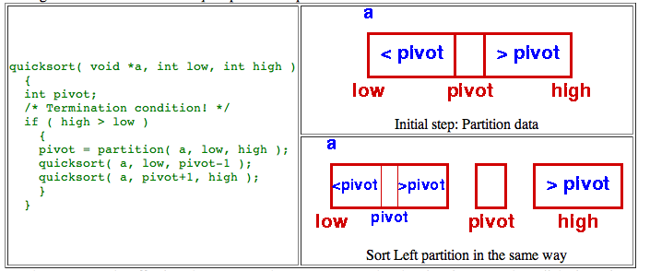
Coding example

Slide 68
Coding example (continue)
int partition(int array[],int data_awal,int data_akhir,int select)
{ int up,down;
int pivot,temp;
pivot=array[data_awal];
up=data_akhir;
down=data_awal;
while(down<up)
{if(select==1)//ascending order
{while((array[down]<=pivot)&&(down<data_akhir))
down++;
while(array[up]>pivot)
up--;}
else if(select==2)//descending order
{
while((array[down]>=pivot)&&(down<data_akhir))
down++;
while(array[up]>pivot)
up--;}
if(down<up)
{temp=array[up];
array[up]=array[down];
array[down]=temp;}
}
array[data_awal]=array[up];
array[up]=pivot;
return(up);
}

Slide 69
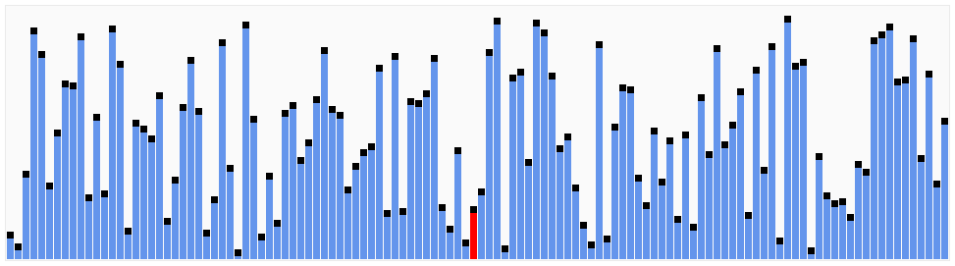
MERGE SORT

Slide 70
MERGE SORT
The sorting algorithm Merge sort produces a sorted sequence by sorting its two halves and merging them. With a time complexity of O(n log(n)) Merge sort is optimal.

Slide 71
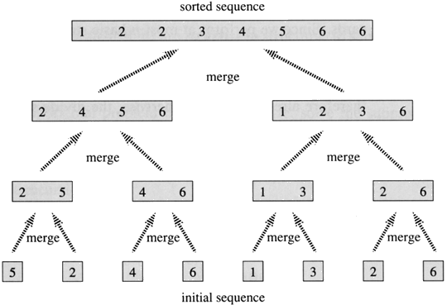
MERGE SORT

Slide 72
Merge sort
Merge sort is the algorithm of choice for a variety of situations: when stability is required, when sorting linked lists, and when random access is much more expensive than sequential access (for example, external sorting on tape).
There do exist linear time in-place merge algorithms for the last step of the algorithm, but they are both expensive and complex. The complexity is justified for applications such as external sorting when Θ(n) extra space is not available.

Slide 73
Merge Sort Algorithm
If the list contains only one element, it is already sorted.
If the list contains two elements, these elements are either in the correct order and the list is already sorted, or they are not, so interchange them.
Otherwise, divide the list in half, sort each of the two halves, and then merge them.

Slide 74
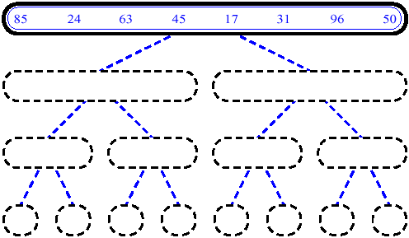
MergeSort (Example) - 1

Slide 75
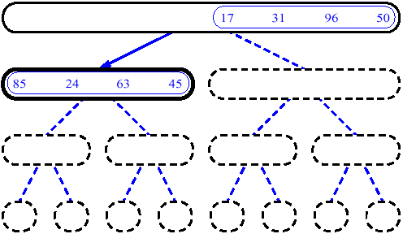
MergeSort (Example) - 2

Slide 76
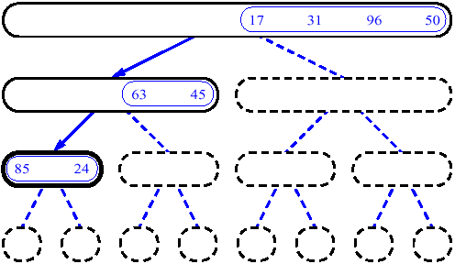
MergeSort (Example) - 3

Slide 77
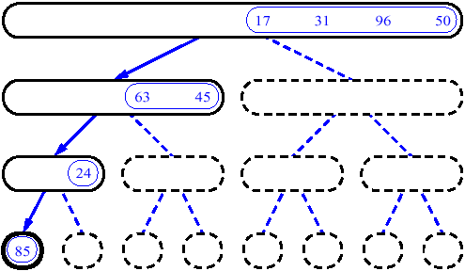
MergeSort (Example) - 4

Slide 78
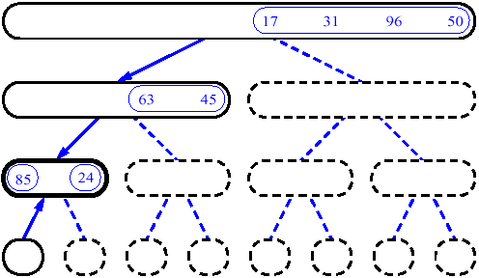
MergeSort (Example) - 5

Slide 79
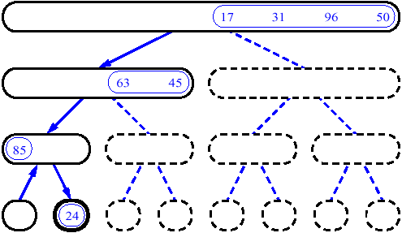
MergeSort (Example) - 6

Slide 80
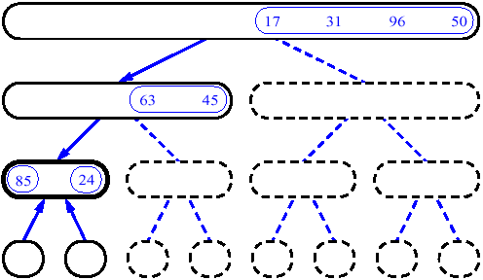
MergeSort (Example) - 7

Slide 81
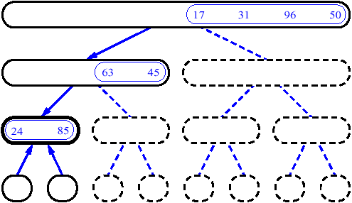
MergeSort (Example) - 8

Slide 82
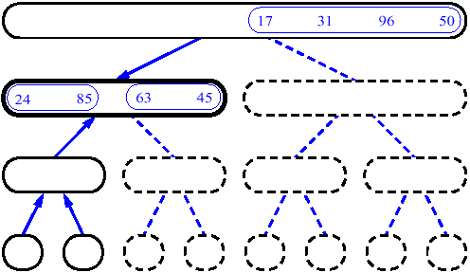
MergeSort (Example) - 9

Slide 83
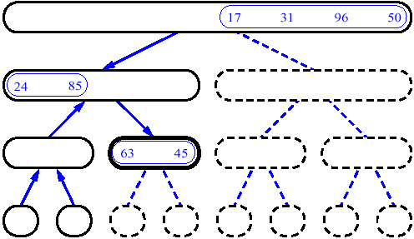
MergeSort (Example) - 10

Slide 84
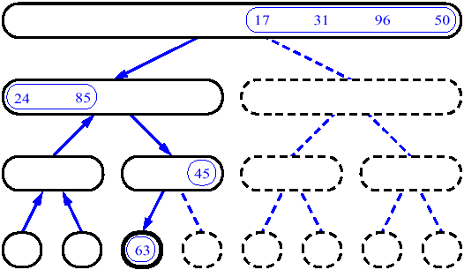
MergeSort (Example) - 11

Slide 85
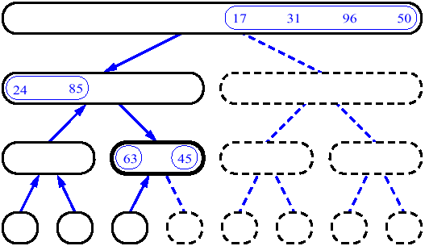
MergeSort (Example) - 12

Slide 86
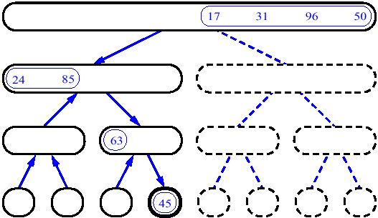
MergeSort (Example) - 13

Slide 87
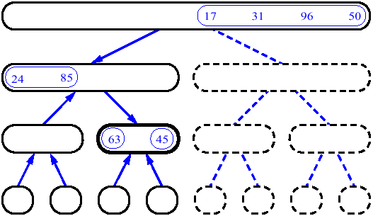
MergeSort (Example) - 14

Slide 88
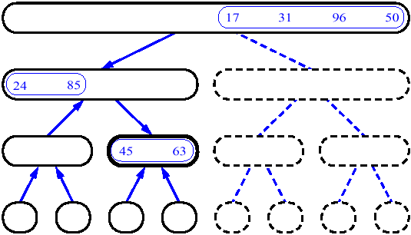
MergeSort (Example) - 15

Slide 89
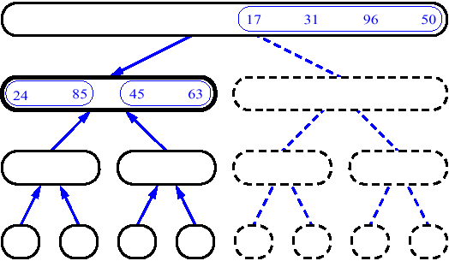
MergeSort (Example) - 16

Slide 90
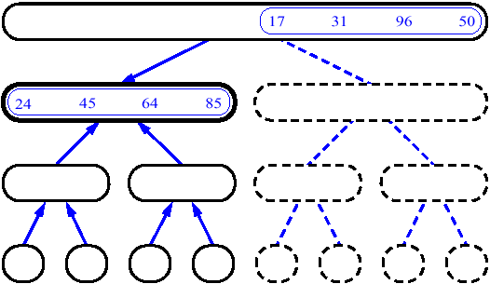
MergeSort (Example) - 17

Slide 91
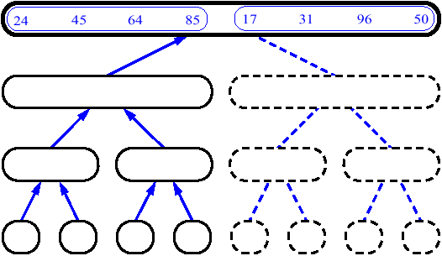
MergeSort (Example) - 18

Slide 92
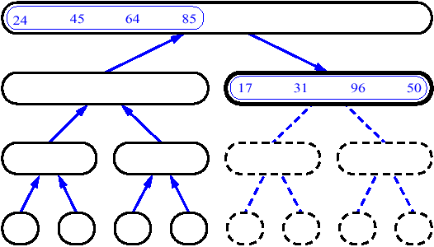
MergeSort (Example) - 19

Slide 93
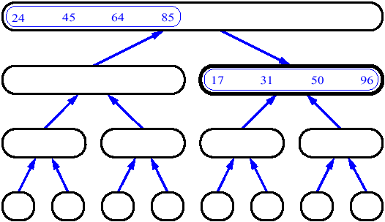
MergeSort (Example) - 20

Slide 94
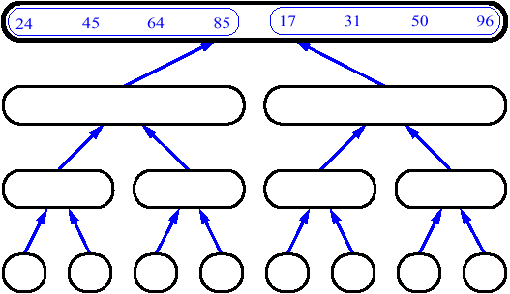
MergeSort (Example) - 21

Slide 95
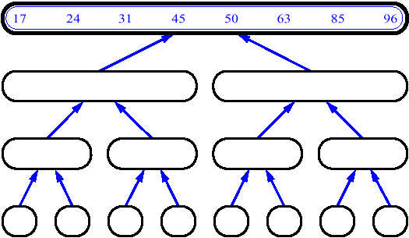
MergeSort (Example) - 22

Slide 96
14
23
45
98
6
33
42
67

Slide 97
14
23
45
98
6
33
42
67
Merge

Slide 98
14
23
45
98
6
33
42
67
6
Merge

Slide 99
14
23
45
98
6
33
42
67
6
14
Merge

Slide 100
14
23
45
98
6
33
42
67
6
14
23
Merge

Slide 101
14
23
45
98
6
33
42
67
6
14
23
33
Merge

Slide 102
14
23
45
98
6
33
42
67
6
14
23
33
42
Merge

Slide 103
14
23
45
98
6
33
42
67
6
14
23
33
42
45
Merge

Slide 104
14
23
45
98
6
33
42
67
6
14
23
33
42
45
67
Merge

Slide 105
14
23
45
98
6
33
42
67
6
14
23
33
42
45
67
98
Merge

Slide 106
Example
Sorting a list using merge sort:
Original (Z A C F Q B G K P N D E M H R T)
Divide (Z A C F Q B G K)(P N D E M H R T)
Divide (Z A C F)(Q B G K)(P N D E)(M H R T)
Divide (Z A)(C F)(Q B)(G K)(P N)(D E)(M H)(R T)
Sort pairs (A Z)(C F)(B Q)(G K)(N P)(D E)(H M)(R T)
Merge (A C F Z)(B G K Q)(D E N P)(H M R T)
Merge (A B C F G K Q Z)(D E H M N P R T)
Merge (A B C D E F G H K M N P Q R T Z)

Slide 107
Merge Sort Code
void merge(int* input, int p, int r)
{
int mid = floor((p + r) / 2);
int i1 = 0;
int i2 = p;
int i3 = mid + 1;
// Temp array
int temp[r-p+1];
// Merge in sorted form the 2 arrays
while ( i2 <= mid && i3 <= r )
if ( input[i2] < input[i3] )
temp[i1++] = input[i2++];
else
temp[i1++] = input[i3++];
// Merge the remaining elements in left array
while ( i2 <= mid )
temp[i1++] = input[i2++];
// Merge the remaining elements in right array
while ( i3 <= r )
temp[i1++] = input[i3++];
// Move from temp array to master array
for ( int i = p; i <= r; i++ )
input[i] = temp[i-p];
}

Slide 108
Merge Sort Example
Default | 40 | 23 | 34 | 1 | 99 | 11 | 66 | 8 | 57
void merge_sort(int* input, int p, int r)
{
if ( p < r )
{
int mid = floor((p + r) / 2);
merge_sort(input, p, mid);
merge_sort(input, mid + 1, r);
merge(input, p, r);
}
}
This one is the most trickiest
It is recursive function that you need to understand thoroughly

Slide 109
Merge Sort Example
Default | 40 | 23 | 34 | 1 | 99 | 11 | 66 | 8 | 57
void merge_sort(int* input, int p, int r)
{
if ( p < r )
{
int mid = floor((p + r) / 2);
merge_sort(input, p, mid);
merge_sort(input, mid + 1, r);
merge(input, p, r);
}
}
p=0,r=9
At first mid = 4
Go inside the merge_sort
Merge_sort(input,0,4)
Then mid = 2
Go inside the merge_sort
Merge_sort(input,0,2)
mid = 1
Go inside the merge_sort
Merge_sort(input,0,1)
mid = 0
Go to Merge(input,0,1)
..

Slide 110
Merge Sort Example (Cont)
Default | 40 | 23 | 34 | 1 | 99 | 11 | 66 | 8 | 57
int mid = floor((p + r) / 2);
int i1 = 0;
int i2 = p;
int i3 = mid + 1;
// Temp array
int temp[r-p+1];
p=0,r=1
i1=0,i2=0,i3=1
temp[2]

Slide 111
Merge Sort Example (Cont)
Default | 40 | 23 | 34 | 1 | 99 | 11 | 66 | 8 | 57
while ( i2 <= mid && i3 <= r )
if ( input[i2] < input[i3] )
temp[i1++] = input[i2++];
else
temp[i1++] = input[i3++];
p=0,r=1
i1=0,i2=0,i3=1
temp[2]
0<=1 && 0<=1
If (input[0]<input[0])
temp[0]=input[1]=23

Slide 112
Merge Sort Example (Cont)
Default | 40 | 23 | 34 | 1 | 99 | 11 | 66 | 8 | 57
while ( i2 <= mid )
temp[i1++] = input[i2++];
while ( i3 <= r )
temp[i1++] = input[i3++];
for ( int i = p; i <= r; i++ )
input[i] = temp[i-p];
}
p=0,r=1
..
i1=1,i2=0,i3=2
0<=0
temp[1]=input[0]=40
i3<=r is not true
..
For loop
input[0]=temp[0]=23
input[1]=temp[1]=40

Slide 113
Merge Sort Example By View
Default | 40 | 23 | 34 | 1 | 99 | 11 | 66 | 8 | 57
LEFT | 23 | 40
LEFT | 23 | 34 | 40
LEFT |  |  |  | 1 | 99
LEFT | 1 | 23 | 34 | 40 | 99
RIGHT |  |  |  |  |  | 11 | 66
RIGHT |  |  |  |  |  |  |  | 8 | 57
RIGHT |  |  |  |  |  | 8 | 11 | 57 | 66
END | 1 | 8 | 11 | 23 | 34 | 40 | 57 | 66 | 99
http://www.cse.iitk.ac.in/users/dsrkg/cs210/applets/sortingII/mergeSort/mergeSort.html

Slide 114
Quick Sort & Merge Sort of N elements:
How many comparisons?
The entire array can be subdivided into halves
only log₂N times.
Each time it is subdivided, function Merge is called
to re-combine the halves. Function Merge uses a
temporary array to store the merged elements.
Merging is O(N) because it compares each element
in the subarrays.
Copying elements back from the temporary array
to the values array is also O(N).
MERGE SORT IS O(N*log₂N).

