Slide 1
Numerical Methods:
Chapter 2:
ROOT FINDINGS

Slide 2
What computers can’t do
Solve (by reasoning) general mathematical problems → they can only repetitively apply arithmetic primitives to input.
Solve problems exactly.
Represent all numbers. Only a finite subset of the numbers between 0 and 1 can be represented.

Slide 3
Finding roots / solving equations
General solution exists for equations such as
ax² + bx + c = 0
The quadratic formula provides a quick answer to all quadratic equations.
However, no exact general solution (formula) exists for equations with exponents greater than 4.

Slide 4
Roots Finding …
Even if “exact” procedures existed, we are stuck with the problem that a computer can only represent a finite number of values… thus, we cannot “validate” our answer because it will not come out exactly
However we can say how accurate our solution is as compared to the “exact” solution

Slide 5
Roots Finding , continued
Transcendental equations: involving geometric functions (sin, cos), log, exp. These equations cannot be reduced to solution of a polynomial.
Convergence: we might imagine a “reasonable” procedure for finding solutions, but can we guarantee it terminates?

Slide 6
Problem-dependent decisions
Approximation: since we cannot have exactness, we specify our tolerance to error
Convergence: we also specify how long we are willing to wait for a solution
Method: we choose a method easy to implement and yet powerful enough and general
Put a human in the loop: since no general procedure can find roots of complex equations, we let a human specify a neighbourhood of a solution

Slide 7
Practical approach - hand calculations
Choose method and initial guess wisely
Good idea to start with a crude graph. If you are looking for a single root you only need one positive and one negative value
If even a crude graph is difficult, generate a table of values and plot graph from that.

Slide 8
Practical approach - example
Example
e^{-x} = sin(πx/2)
Solve for x.
Graph functions - the crossover points are solutions
This is equivalent to finding the roots of the difference function:
f(x)= e^{-x} - sin(πx/2)

Slide 9
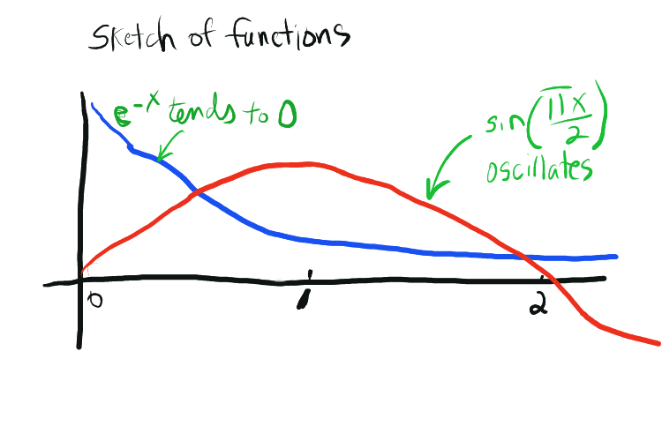
Graph

Slide 10
Roots Finding Methods
Root Finding
Bracketing Methods
Graphical
Bisection
False position
Open Methods
Fixed-point iteration
Newton Raphson
Secant
Incremental searches
Multiple Roots
Nonlinear systems

Slide 11
Bracketing Methods
Bisection
Method

Slide 12
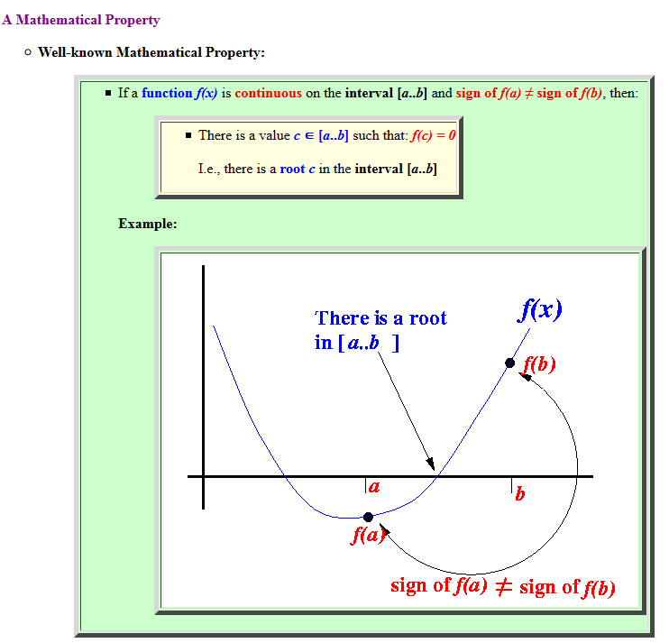

Slide 13
The Bisection Method
BM is a successive approximation method that narrows down an interval that contains a root of the function f(x)
BM given an initial interval [a..b] that contains a root (We can use the property sign of f(a) ≠ sign of f(b) to find such an initial interval)
BM will cut the interval into 2 halves and check which half interval contains a root of the function
BM will keep cut the interval in halves until the resulting interval is extremely small
The root is then approximately equal to any value in the final (very small) interval.
Notes:
Bisection method is the simplest among all the numerical schemes to solve the transcendental equations. This scheme is based on the intermediate value theorem for continuous functions

Slide 14
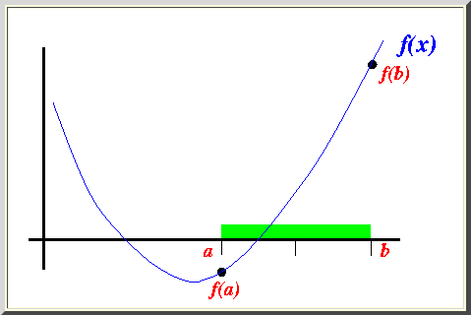
2. Suppose the interval [a..b] is as follows:

Slide 15
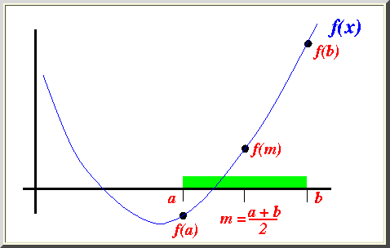
3. We cut the interval [a..b] in the middle: m = (a+b)/2

Slide 16
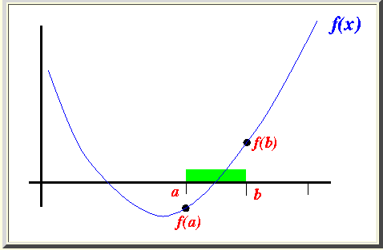
Because sign of f(m) ≠ sign of f(a) or f(m) * f(a) < 0 , we proceed with the search in the new interval [a..b]:
We can use this statement to change to the new interval:
b = m;
In the above example, we have changed the end point b to obtain a smaller interval that still contains a root

Slide 17
Algorithm – Bisection Method
Given a function f (x) continuous on an interval [a,b] and
f (a) * f (b) < 0
Do
m = (a+b)/2
if f (a) * f (m) < 0 then b = m
else a = m
while (none of the convergence criteria C1, C2 or C3 is satisfied)
C1. Fixing the total number iterations N
C2. By testing the condition | m_{i} - m _{i-1}| (where i are the iteration number) less
than some tolerance limit, say epsilon
C3. By testing the condition | f (m_{i} ) | less than some tolerance limit

Slide 18
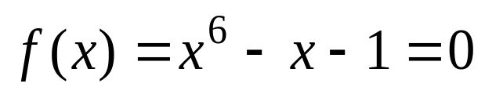
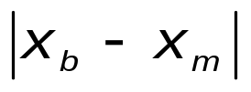
Example 1:
Using the bisection method, find the root of
accurate to within ε = 0.05. Given that x_{a} = 1 and x_{b} = 2.
n | x_{a} | x_{b} | x_{m} | f(x_{a}) | f(x_{m})
1 | 1.0000 | 2.0000 | 1.5000 | -1 | 8.8906 | 0.5000
2 | 1.0000 | 1.5000 | 1.2500 | -1 | 1.5647 | 0.2500
3 | 1.0000 | 1.2500 | 1.1250 | -1 | -0.0977 | 0.1250
4 | 1.1250 | 1.2500 | 1.1875 | -0.0977 | 0.6167 | 0.0625
5 | 1.1250 | 1.1875 | 1.1562 | -0.0977 | 0.2333 | 0.0312
∴ x = 1.1562.

Slide 19
Pros and Cons- Bisection Method
The method is guaranteed to converge
The error bound decreases by half with each iteration
The method converge very slowly
The method cannot detect multiple roots

Slide 20
Open Methods
Fixed-point iteration
Newton Raphson
Secant

Slide 21

FIXED-POINT ITERATION METHOD
In open methods, a formula was developed for simple fixed-point iteration by rearrangging the function
$$x = g(x)$$
This transformation can be accomplished either by algebraic manipulation or by simply adding x to both sides of the original example.

Slide 22
FIXED-POINT ITERATION ALGORITHM
Given an equation f(x) = 0
Convert f(x) = 0 into the form x = g(x)
Let the initial guess be x₀
Do
x_{i+1}= g(x_{i})
while (none of the convergence criterion C1 or C2 is met)
C1. Fixing apriori the total number of iterations N .
C2. By testing the condition | x_{i+1} - g(x_{i}) | (where i is the iteration number) less
than some tolerance limit, say epsilon.
Notes:
A point, say, s is called a fixed point if it satisfies the equation x = g(x).

Slide 23
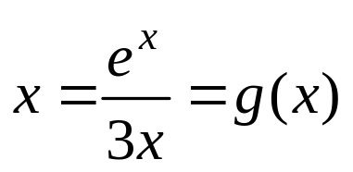
Example 2
Use simple fixed-point iteration to locate the root of
f(x) = e^{x} − 3x² = 0 accurate to within ε = 0.0001.
We can rewrite the equation as:
Assume x₀ = 1
i | x_{i} | ⏐x_{i} -x_{i −1}⏐
1 | 0.9061
2 | 0.9104 | 0.0043
3 | 0.9100 | 0.0004
4 | 0.9100 | 0.0000
Thus, each iteration brings the estimate closer to the true value of the root: 0.9100.

Slide 24
Pros and Cons- Fixed Point iteration Method
The method is guaranteed to converge
The error bound decreases by half with each iteration
The method converge very slowly
The method cannot detect multiple roots

Slide 25
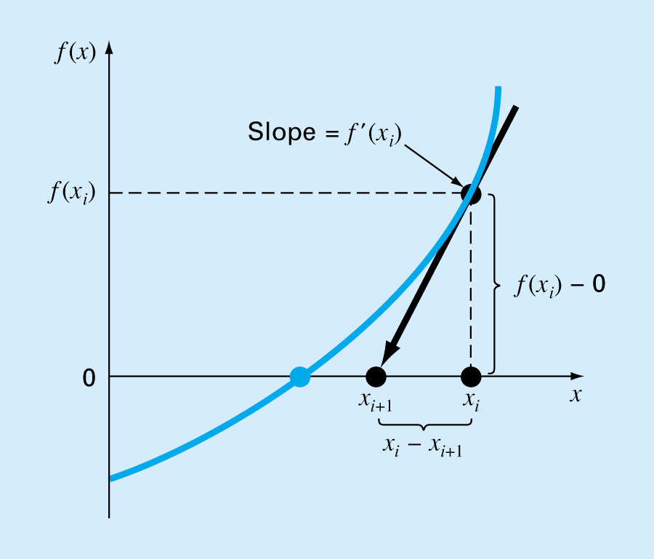
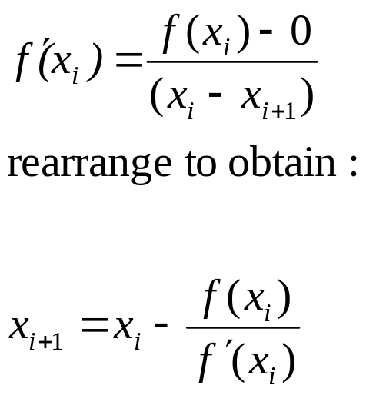
Newton-raphson method
Most widely used formula for locating roots.
Can be derived using Taylor series or the geometric interpretation of the slope in the figure

Slide 26
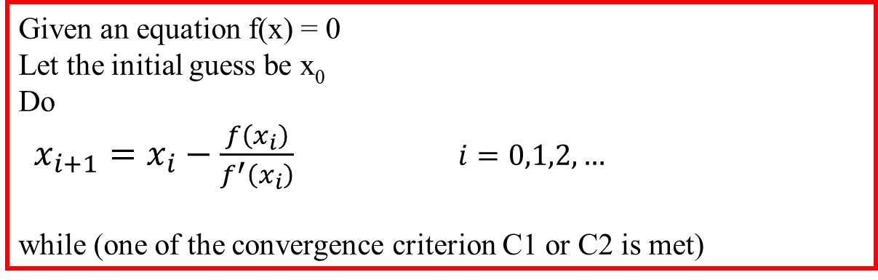
NEWTON RAPHSON ALGORITHM
Given an equation f(x) = 0
Let the initial guess be x₀
Do
$x_{i+1}=x_{i}−\frac{f\left(x_{i}\right)}{f^{′}\left(x_{i}\right)}$ $i=0,1,2,…$
while (one of the convergence criterion C1 or C2 is met)
C1. Fixing apriori the total number of iterations N.
C2. By testing the condition | x_{i+1} - x_{i} | (where i is the iteration number) less
than some tolerance limit, say epsilon
Notes:
Let the given equation be f(x) = 0 and the initial approximation for the root is x₀. Draw a tangent to the curve y = f(x) at x₀ and extend the tangent until x-axis. Then the point of intersection of the tangent and the x-axis is the next approximation for the root of f(x) = 0. Repeat the procedure with x₀ = x₁ until it converges. If m is the slope of the Tangent at the point x ₀ and b is the angle between the tangent and x-axis then

Slide 27
Example 3
Use the Newton-Raphson method to estimate the root of
f(x) = 0.9x² + 1.7x − 5
employing an initial guess of x₀ = 1 accurate to within ε = 0.001.
We have f(x) = 0.9x² + 1.7x − 5 ,
So f’(x) = 1.8x + 1.7
i | x_{i} | f(x_{i}) | f ’(x_{i}) | f(x_{i})/ f ’(x_{i}) | ⏐x_{i} -x_{i−1}⏐
0 | 1 | −2.4 | 3.5 | −0.6857
1 | 1.6857 | 0.4232 | 4.7343 | 0.0894 | 0.6857
2 | 1.5963 | 0.0072 | 4.5734 | 0.0016 | 0.0894
3 | 1.5947 | −0.0002 | 4.5705 | −0.00004 | 0.0016
4 | 1.5947 | −0.0002 | 4.5705 | −0.00004 | 0.0000
x ≈ 1.5947

Slide 28
Pros and Cons- newton raphson method
The method is very fast
The error decreases rapidly with each iteration
Unfortunately, for bad choices of x0 (initial guess) the method can fail to converge.
Is a convenient method if f ’(x) (the derivative) can be evaluated analytically

Slide 29
Secant method
The secant method is a recursive method used to find the solution to an equation like Newton’s Method.
The idea for it is to follow the secant line to its x-intercept and use that as an approximation for the root.
This is like Newton’s Method (which follows the tangent line) but it requires two initial guesses for the root.

Slide 30
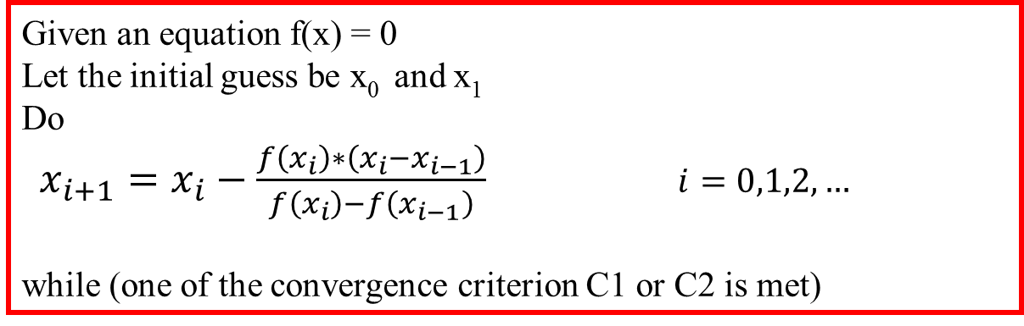
Secant Method
Given an equation f(x) = 0
Let the initial guess be x₀ and x₁
Do
$x_{i+1}=x_{i}−\frac{f\left(x_{i}\right)∗\left(x_{i}−x_{i−1}\right)}{f\left(x_{i}\right)−f\left(x_{i−1}\right)}$ $i=0,1,2,…$
while (one of the convergence criterion C1 or C2 is met)
C1. Fixing apriori the total number of iterations N.
C2. By testing the condition | x_{i+1} - x_{i} | (where i is the iteration number) less
than some tolerance limit, say epsilon
Notes:
The Newton-Raphson algorithm requires the evaluation of two functions (the function and its derivative) per each iteration. If they are complicated expressions it will take considerable amount of effort to do hand calculations or large amount of CPU time for machine calculations. Hence it is desirable to have a method that converges (please see the section order of the numerical methods for theoretical details) as fast as Newton's method yet involves only the evaluation of the function.

Slide 31
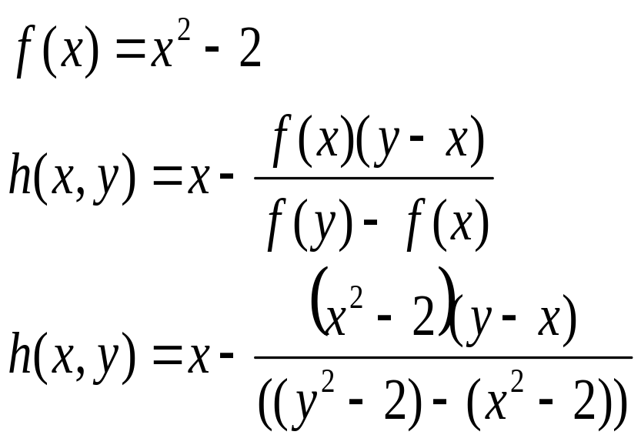
Example 4
n | x_{n} | h(x_{n-1},x_{n})
0 | 0
1 | 1 | 2
2 | 2 | 1.33333
3 | 1.33333 | 1.4

Slide 32
Pros and Cons- Secant method
  The big advantage of the secant method over Newton’s Method is that it does not require the given function f(x) to be a differential function or for the algorithm to have to compute a derivative. This can be a big deal in other languages since many derivatives can only be estimated.
  The number of iterations required can not be determined before the algorithm begins.
  The algorithm will halt (program termination by division by zero if not checked for) if a horizontal secant line is encountered.
  The secant method will sometimes find an extraneous root.

